Slide 1
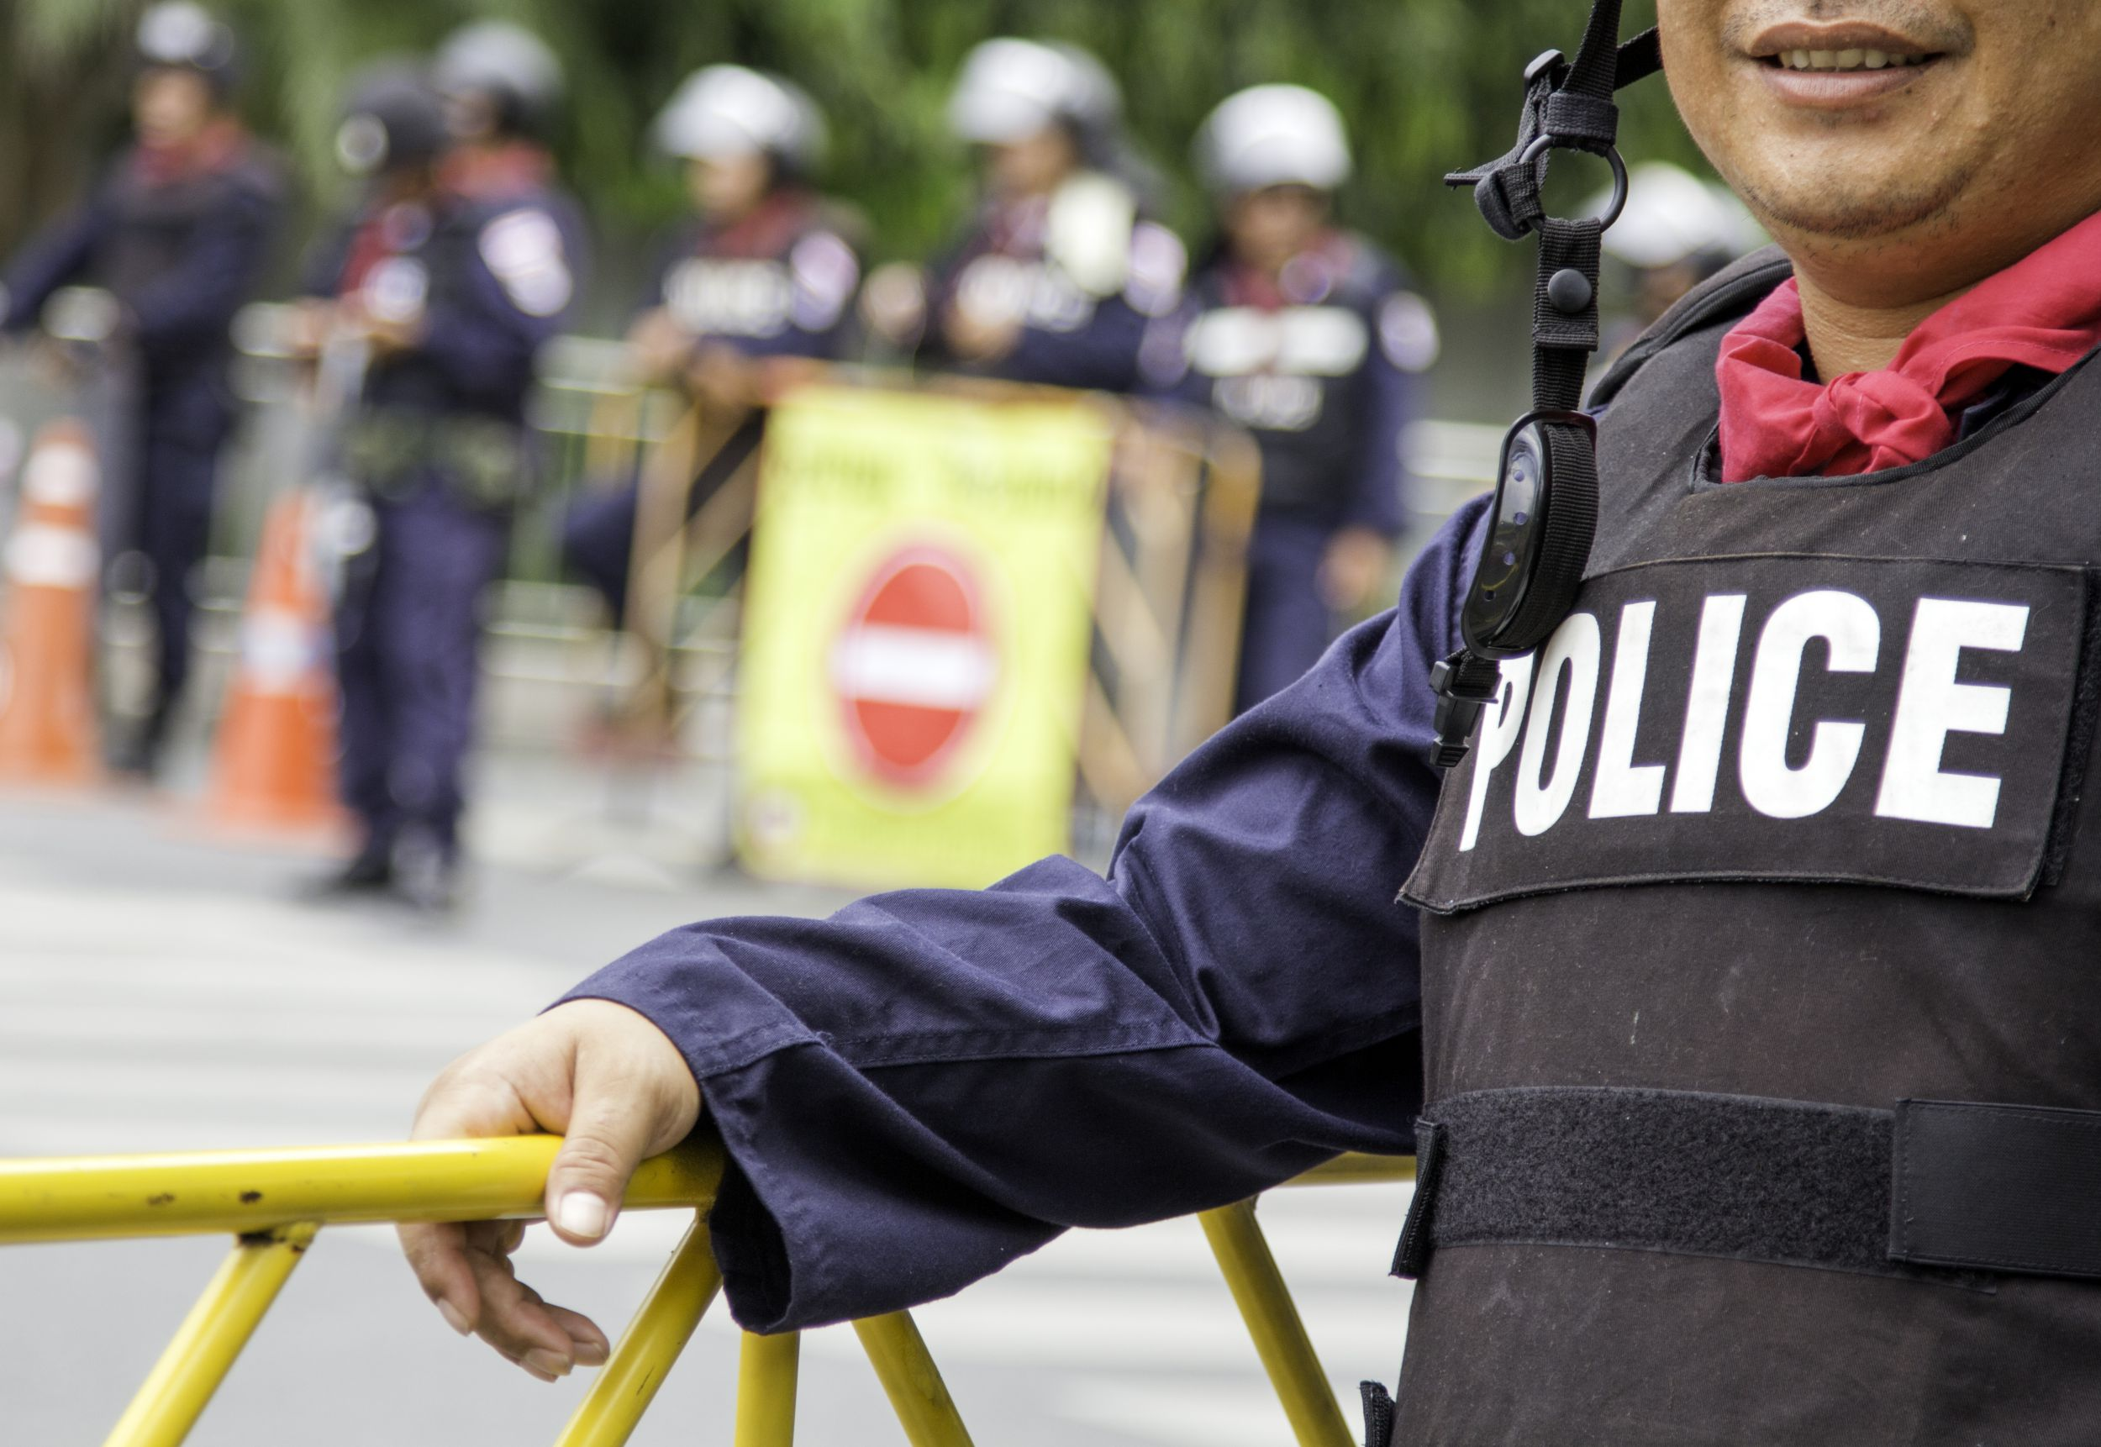

Police killings in US
ademola olabode peter

Slide 2
Introduction
Domain: Crimes, Law enforcement
Link: https://www.kaggle.com/kwullum/fatal-police-shootings-in-the-us/home#PoliceKillingsUS.csv
This dataset is highly reliable as it’s gotten from the Washington post (a major American daily newspaper). Since Jan. 1, 2015, The Washington Post has been compiling a database of every fatal shooting in the US by a police officer in the line of duty. It's difficult to find reliable data from before this period, as police killings haven't been comprehensively documented, and the statistics on police brutality are much less available. As a result, a vast number of cases go unreported.
The Washington Post is tracking more than a dozen details about each killing - including the race, age and gender of the deceased, whether the person was armed, and whether the victim was experiencing a mental-health crisis. They have gathered this information from law enforcement websites, local new reports, social media, and by monitoring independent databases such as "Killed by police" and "Fatal Encounters". The Post has also conducted additional reporting in many cases.
The Washington post online link: https://www.washingtonpost.com/
Source of census data: https://factfinder.census.gov/faces/nav/jsf/pages/community_facts.xhtml

Slide 3
Description of the Dataset
ID: Unique identifier for the record
Composite variable generated: By Combining the state and city
Sign of Mental Illness: Again this is a really sensitive topic. Mental illness such as depression (postpartum depression- which happens to nursing mothers can lead to various unpredictably) and psychotic depression (which I suffer from) can lead to hallucinations and the law enforcement agencies might not know how to adequately deal with such cases due to lack of awareness of the illness. Other mental illness like bi-polar disorder, Alzheimer’s and dementia (which tend to occur more in older people) can also lead to more uncharacteristic behaviors among the victim. Again due to stigmatization, people might not be outright if they suffer from mental illness or not.
There could also be a connection between mental illness and if the victim was armed or not
Race of victim: H- Hispanic, B- Black, W- White, N- Native Americans, O – Others , A - Asians
This is a very important factor in this dataset. Most African Americans believe there is a police brutality and racism towards them due to their skin color and they believe that there are mostly killed by the police amongst all the ethnicity. In fact, the 2014 killing of Michael Brown in Ferguson, Missouri, began the protest movement culminating in Black Lives Matter and an increased focus on police accountability nationwide. This brought about Washington post start recording the compiling of database of every fatal shooting in the US by a police officer.
Again as data analyst we based our decisions on facts and not pure emotions. All these are all based on word of mouth and not actual facts. The exploratory analysis of this data will provide further insights into this. If this is true or not.

Slide 4
Description of the Dataset
Name: Name of the deceased/victim
Date: date when the shooting takes place. This could help us identify the number of killings in each day, month and time period.
Manner of death: was the victim shoot, Tasered
Armed: Was the victim armed before he was shoot or tasered? There could be a link between the manner of death variable and armed variable. If the victim was not armed, the law enforcement agency (police) should not shoot or will they? Further analysis on this when we perform exploratory data analytics
Age: Age of the deceased/victim
Gender: Gender of the victim/deceased
City: The city where the killing took place
State: The state where the killing too place. The city and state variables are connected to each other

Slide 5
Description of the Dataset
Threat level: The level of threat exhibited by the victim. If the level of threat was to attack, then the officer may use lethal force according to law enforcement rules. So there could be a connection if the level of threat was to attack then the police might shoot.
Flee: if the victim was fleeing or resisting arrest before they were killed. Again there could be a relationship if the victim was fleeing and was shot (manner of death)
Body camera: This tells if the police officers who are involved have their body cams on or not when the shootings happened, it happens to be a very important factor in this dataset because the police are the ones who do the shooting, and this body cam proves every other factor/variable listed on this dataset, so telling if the police had it on or not can justify the analysis result we would get from analyzing this data.

Slide 6






Questions and issues answered/explored
If it’s true based wild spread propaganda that blacks are the most killed by police out of all the ethnicity.
1
2
If the killings of unarmed individuals are still a wide-spread problem throughout the US
if mental health of suspect was taken considered by officers. And the need to train officers on dealing with mental illness suspects.
.
3
4
What reasons do officer have to turn off their body camera. Is it justified?
Age group of those being killed. Are they mostly teens? What can be done do take them off the streets?
5
6
Are some of these shootings a case of racial profiling?

Slide 7
For whom these questions/issues are important?
Law Enforcement Agencies
various police departments, federal bureau of investigation (FBI) etc.
.
Decision makers
United States government, Mayors, city councils, community leaders
World health organization
on creating awareness on mental health issues and sensitizing law enforcement agencies on it.

Slide 8
actionable intelligence
2
1
the information gathered from the analysis of this dataset can help the police department, the department of justice, mayors of cities, United States government, lawmakers, legislators and even the World health organization (we will get to our they are involved in a moment).
The dashboards generated will provide insights to show different analysis of the shootings of victims giving an in-depth knowledge of the variables that surrounds the death of each victim in the dataset, this helps to tell if the killing of a victim is justifiable or not.
3
5
4
Another actionable insight we can gain is the percentage of suspects who suffer from mental illness, how officers can best respond to such cases and show empathy rather than the aim to shoot and kill.
It can also help the police force in knowing how to reduce the death of victims in the near future by carefully taking all the results gained from this analysis into consideration.
We can get actionable insights like How many teens are killed, what actions can the government, mayors, community leaders take to reduce the number of teens committing crime

Slide 9
Problem Statement
90%
75%
The problem Statement regarding the dataset is “if the killing of the civilians listed on the dataset is it justifiable or not “
65%
60%
50%
40%
25%
Jan
Feb
March
April
May
June
July

Slide 10
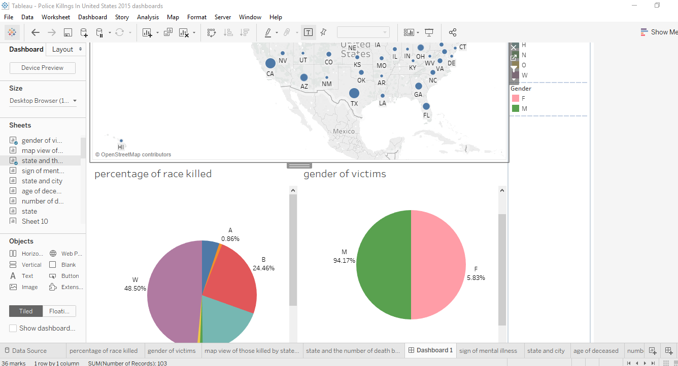
Dashboard 1 is showing the percentage of race killed and the gender in each state. We can filter the results by each state. This is necessary as majority of the blacks believe they are killed by police due to racial profiling. From the dashboard created we filter all results by each state and we can view the most race and gender that has been killed by police officer in each state.
It seems that Whites killed were spread throughout most of the country. Black people seem to make up the lion’s share of the deceased near the crime riddled areas of Baltimore, DC, and Chicago. Hispanics/Latinos understandably made up more of those killed in Hispanic/Latino population heavy states like California, New Mexico, and Texas, and also made up most of the deceased in border towns by Mexico. Southern California seems to have had a heavy combination of all 3 of the mentioned races/ethnicities. Native American deaths seem to have had the highest concentration near/at the Native American reservations of Arizona and New Mexico.
You may notice that black people made up a disproportionately large share (more than 24%) of those killed, while comprising of only 12% of the overall American population. However, trying to find meaningful conclusions purely based on these statistics would mean we are ignoring the confounding factors behind them. According to FBI reports, the homicide rate for black males is 8 times higher than white males. Other people may be tempted to prematurely conclude that higher crime rates are the explanation to black people getting killed at a higher rate. But again, to reach conclusions about a race/ethnicity based on snippets of a dataset like this would not only be incorrect, but also dangerously ignorant. We would be breaking the Golden Rule of Observational Studies: Correlation does not equal Causation. A deeper level of confounding factors such as poverty rate, educational background, and socioeconomic status could arguably much better predict incidences of violent crime among groups.
Target Audience: Mayors, community leaders, law enforcement agencies, citizens
This dashboard can benefit decision making process by providing an avenue where by community leaders and citizens can interact with officers of the law and educate them on the rules of engagement.
Dashboard 1

Slide 11
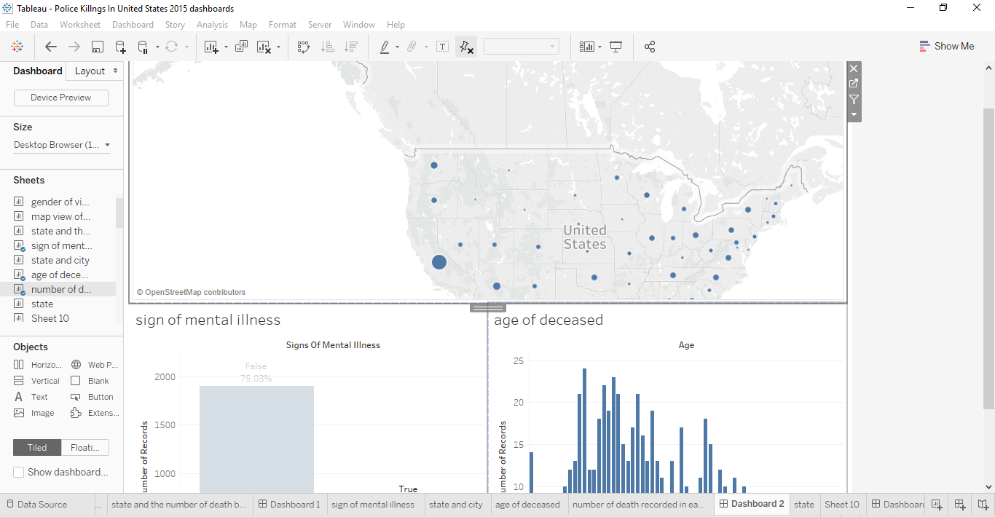
Dashboard 2
Here, we are trying to view the sign of mental illness cases amongst the deceased and their age group. We can also filter by states.
From our dashboard created, we can see the percentage of mental illness case was almost 25%. This is huge considering the fact that approximately 1 in 25 adults in the U.S. (11.2 million) experiences a serious mental illness in a given year that substantially interferes with or limits one or more major life activities. Approximately 1 in 5 youth aged 13–18 (21.4%) experiences a severe mental disorder at some point during their life (Serious Mental Illness (SMI) Among Adults. (n.d.). Retrieved May 13, 2019).
The main issue here is creating mental illness awareness amongst officers and the general public. Officers need to approach suspects who show signs of mental illness with more caution and empathy instead of the aim to shoot and kill. This was the suspect can get the help he/she required.
Training seminars can be organized for law enforcement agencies on educating them on mental illness, how to notice signs of mental illness exhibited by the suspects and how to calm such suspects down.
Target Audience: law enforcement agencies, World health organization, and national institute of mental health (NIMH)

Slide 12
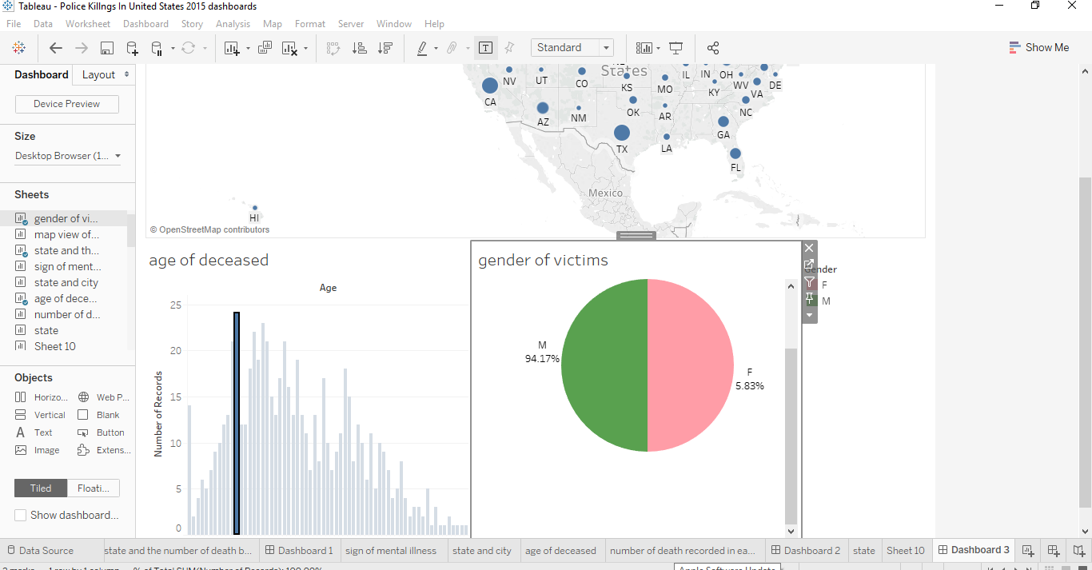
Dashboard 3
For the map below, we are looking at all police killings during 2015 and filtering with the age of the deceased. If you notice the dots in the Kentucky, Tennessee, Virginia, North Carolina area, it seems that those killed there were slightly older than others killed elsewhere. The second insight, which should be obvious to you if you are familiar with the US map, is that the killings were concentrated in the cities, with bigger cities accounting for higher concentrations. No big surprise there.
Target Audience: Mayors, community leaders, law enforcement agencies, citizens

Slide 13
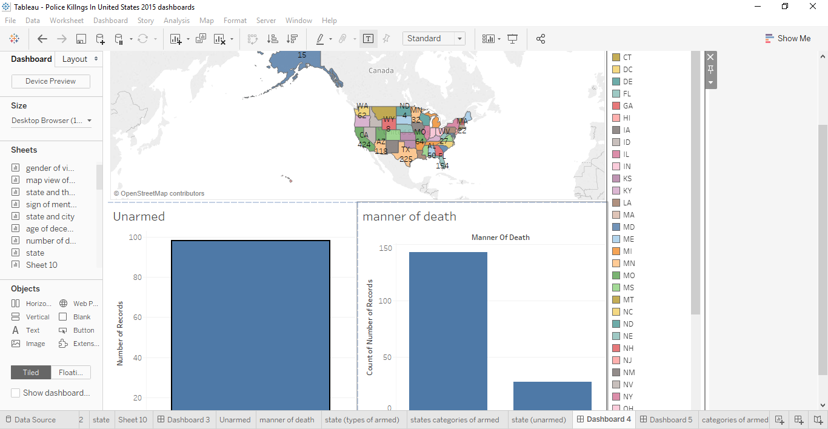
Dashboard 4
This dashboard shows the unarmed victims in each state and whether they were shot or not and try to understand the rational why an officer of the law will shoot an unarmed civilian.
The essence of this dashboard is the wide spread postulation of police brutality in some parts of the United States. If the data is representative of what’s still happening now, then it seems that the killings of unarmed individuals are also a wide-spread problem throughout the US. Gunshots seemed to be the leading cause of death here as well (gunshots are responsible for over 90% of the killings in 2015)
This dashboard can help law enforcement agencies better train their officers on how to handle citizens who are unarmed and not use force while trying to arrest them. Teasers can be used or just simply tackling the individual. It can help improve the decision making of officers.
Target Audience: Mayors, community leaders, law enforcement agencies.
Now let’s investigate how race/ethnicity factors into the picture (done in dashboard 5).

Slide 14
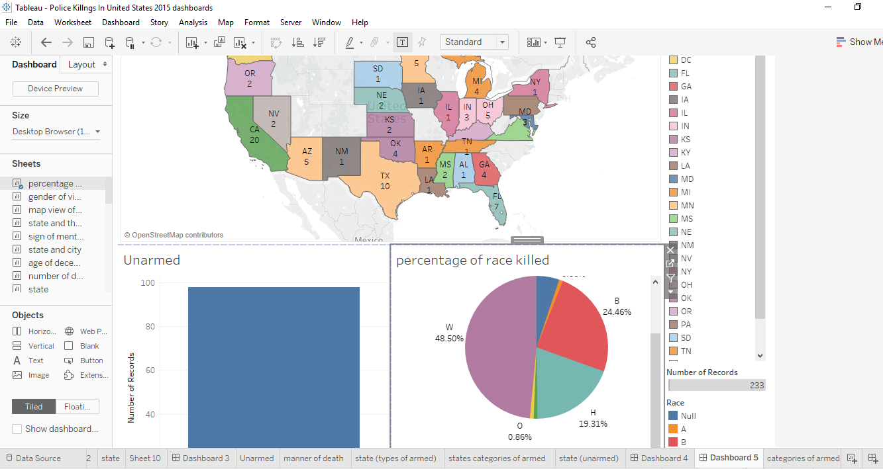
This dashboard is linked with the dashboard above but here it’s investigating how race/ethnicity factors into the picture. It is showing the states and unarmed deceased and the percentage of race/ ethnicity killed.
The deaths of Michael Brown, Eric Garner, Walter Scott, and Freddie Gray are - some claim - evidence of long-standing problems with police racism and excessive violence.
Black people seem to make up the lion’s share of the deceased near the crime riddled areas of Baltimore, DC, and Chicago. Hispanics/Latinos understandably made up more of those killed in Hispanic/Latino population heavy states like California, New Mexico, and Texas, and also made up most of the deceased in border towns by Mexico. Southern California seems to have had a heavy combination of all 3 of the mentioned races/ethnicities. Native American deaths seem to have had the highest concentration near/at the Native American reservations of Arizona and New Mexico.
This dashboard can help law enforcement agencies better train their officers on how to handle citizens who are unarmed and not use force while trying to arrest them. Teasers can be used or just simply tackling the individual. It can help improve the decision making of officers.
Target Audience: Mayors, community leaders, law enforcement agencies.
Dashboard 5

Slide 15
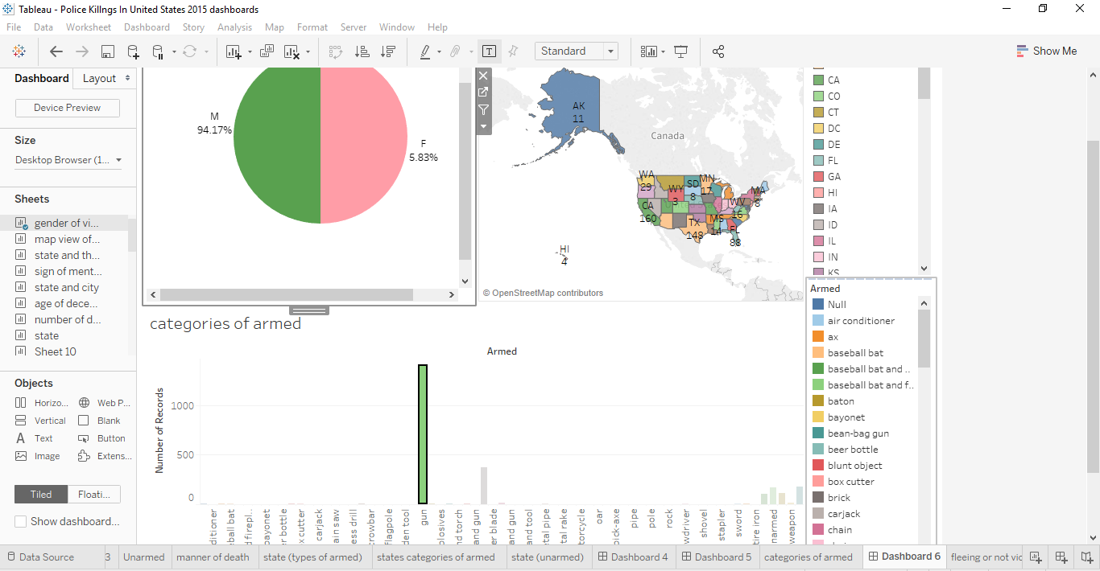
This dashboard shows the type of weapon the deceased was holding before they were shoot by the officers.
From the dashboard below, guns was the most popular weapon held by the deceased as it accounts for 55.15% of the total categories of weapon. This is a huge amount and this shows the major problem of America which is gun control. California has the most cases, followed by Texas.
Following a series of mass shootings in the US in recent years, there has been little in the way of sweeping gun-control reforms.
On the federal level, at least, the interest and attention in new legislation has led to almost no action in decades, despite numerous polls showing widespread public support for measures like strengthened background checks and banning certain types of high-capacity gun magazines and military-style assault rifles.
They can follow New Zealand’s lead and ban guns in the states. .
This dashboard can help decision makers like the United States government, senators and legislators in providing strict controls to gun regulation or just follow New Zealand’s lead and ban guns
Target Audience: united state government, senators, legislators and law enforcement agencies.
Dashboard 6

Slide 16
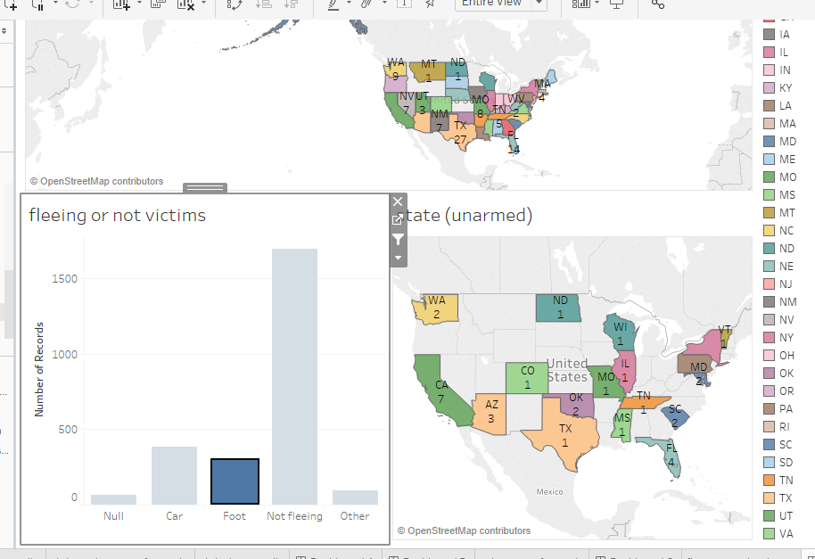
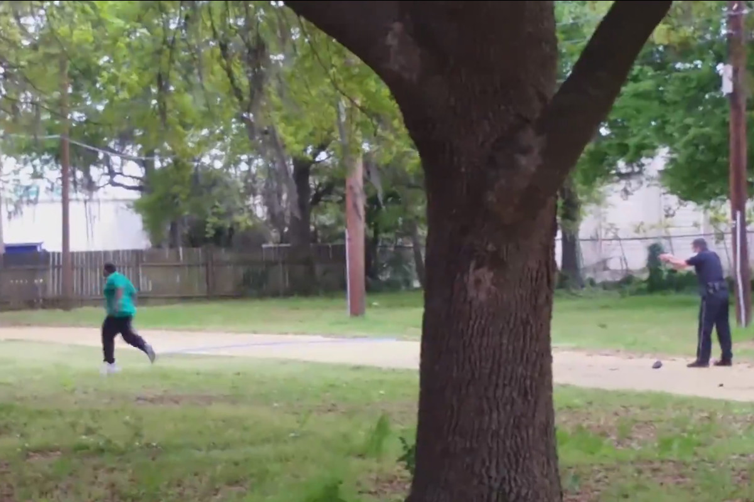
Dashboard 7
a screenshot taken from video of the police shooting of Walter Scott. New York Times
Here we are trying to analyze if the deceased flee or not and tried to resist arrest, if they were unarmed and the total count in each states.
The most concern here are victims who were not armed and where not fleeing but they were shoot either way. What judgment did the officer use to decide he/she needs to take a shot at the victim?
Also victims who are unarmed but fleeing. A case study here would be Walter Scott, a 50-year-old black man, was unarmed, facing away from a white police officer, and haphazardly attempting to flee in North Charleston, South Carolina. That didn't stop the officer, Michael Slager, from firing his gun at least eight times at the fleeing man, killing him.
This dashboard could help law enforcement agencies on what to do if a suspect if unarmed and not fleeing or if they are unarmed but fleeing. They could organize re orientation camps for their officers and other weapon handling trainings.
Target Audience: law enforcement agencies

Slide 17
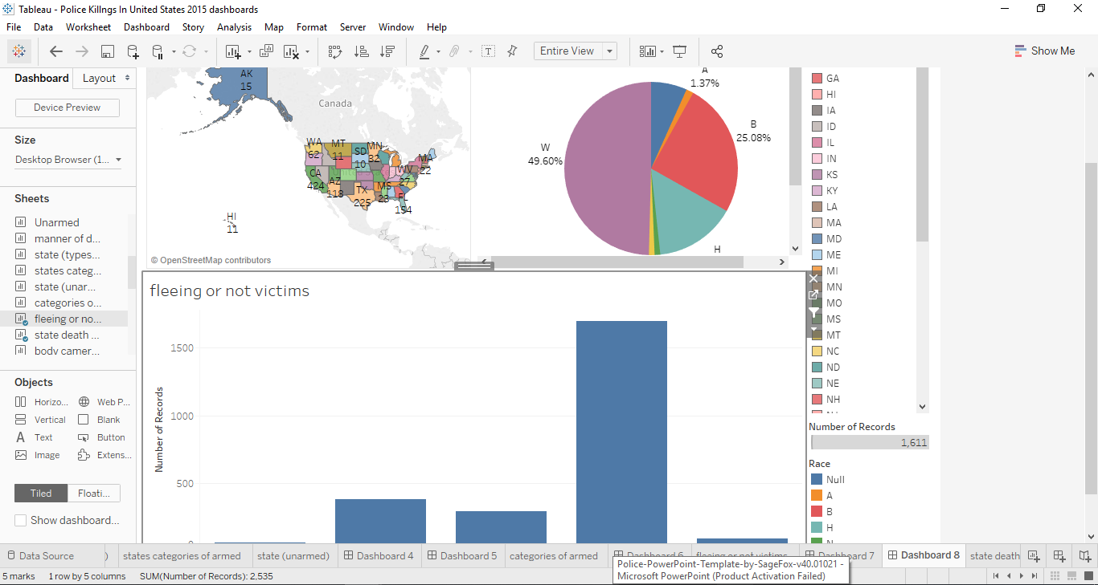
This dashboard links with the above dashboard (dashboard 7) by showing the percentage of ethnicity/race shoot by the police depending if they were fleeing or not.
Black people seem to make up the lion’s share of the deceased near the crime riddled areas of Baltimore, DC, and Chicago. Hispanics/Latinos understandably made up more of those killed in Hispanic/Latino population heavy states like California, New Mexico, and Texas, and also made up most of the deceased in border towns by Mexico. Southern California seems to have had a heavy combination of all 3 of the mentioned races/ethnicities. Native American deaths seem to have had the highest concentration near/at the Native American reservations of Arizona and New Mexico.
This dashboard could help law enforcement agencies on what to do if a suspect if unarmed and not fleeing or if they are unarmed but fleeing. They could organize re orientation camps for their officers and other weapon handling trainings.
Target Audience: law enforcement agencies, citizens, community leaders and mayors
Dashboard 8

Slide 18
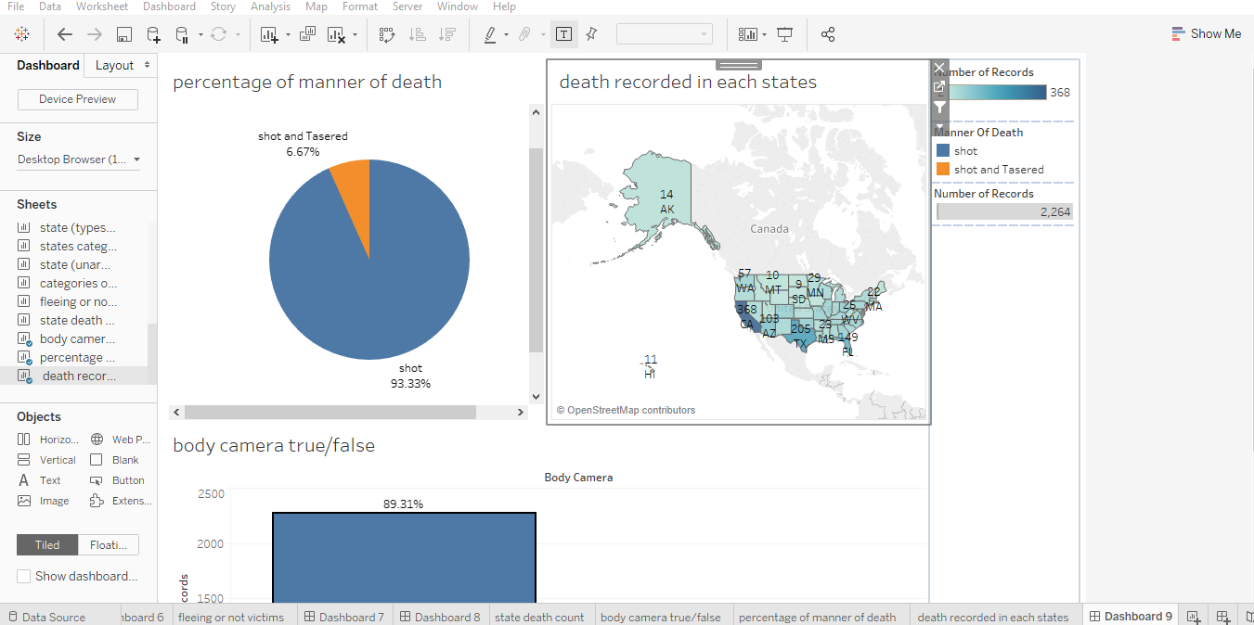
In this dashboard we are trying to figure out whether or not the officers involved in the shooting turned on the body camera during the shooting. Filtered by states and manner of death.
On a general overview we can see that the officers didn’t turn on their body camera with a staggering rate of 89.3% and they turn it on 10.69%. That’s a huge number. There is no excuse that an officer should turn off their body camera while making an arrest. An example would be the officer who shot and killed 18-year-old Paul O’Neal. The officer was wearing a body camera during the shooting, but the camera was turned off at the time.
Due to the frequent rate of officers turning of body cameras during shooting, there are plans to make a proposed Tennessee law would make it a felony for police officers to disable their body cams.
This dashboard can help decision makers such as law makers and legislators to pass bill to prohibit officers of the law from turning of their body camera.
Target Audience: law makers, legislators, senators, United States government, law enforcement agencies, citizens, community leaders and mayors
Dashboard 9

Slide 19
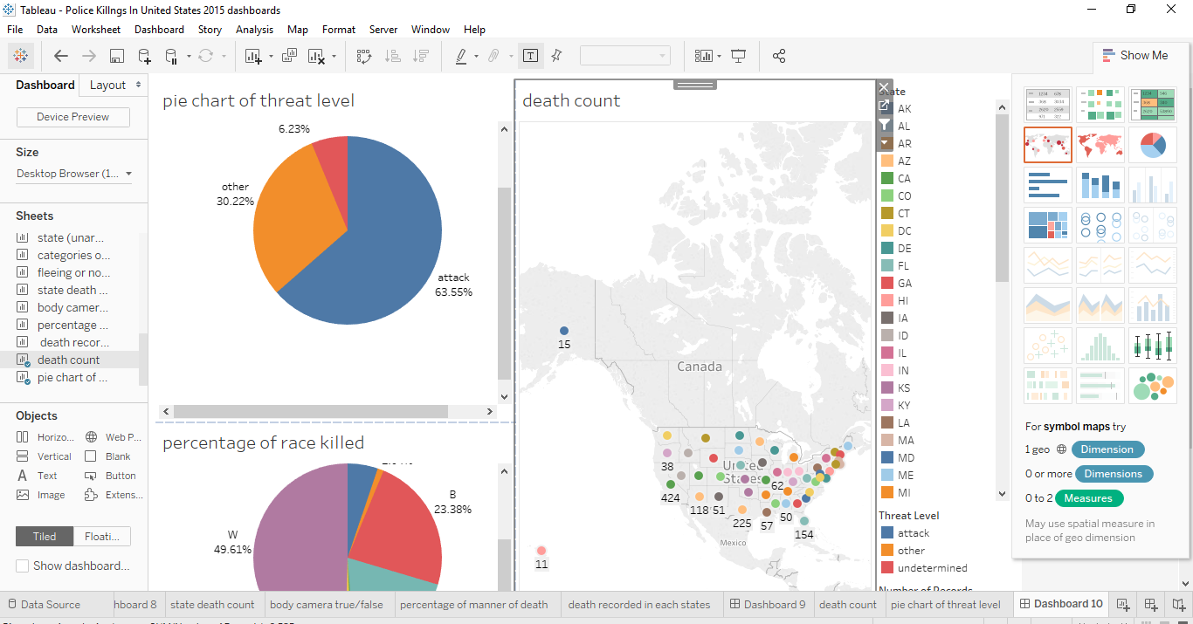
Dashboard 10
Here we are trying to see if the level of perceived threat is based on race (racial profiling).
From the dashboard creating we see if the level threat perceived is to attack 50% of the blacks are killed. That’s a huge number considering the percentage of blacked killed by police officers was almost 25%. So it that 50% of those tagged as attack was shoot and killed.
Decision makers can use this dashboard to know the level of threat perceived by officers based on the weapon held by person’s involved and better train they personnel’s on how to deal with the persons involved based on what they armed with.
Target Audience: law enforcement agencies

Slide 20
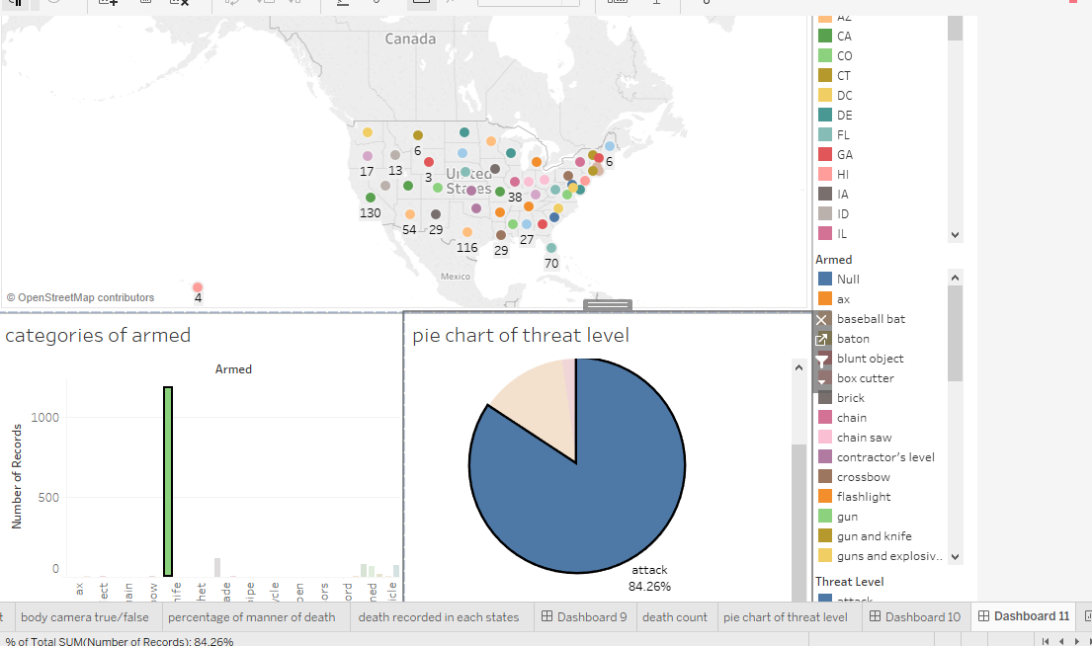
This dashboard links with dashboard 10 above. Here we are trying to know the treat level perceived based on the weapon held by the deceased and if the officers involved in the shooting were justified in shooting the deceased based on the level of threat perceived.
From the dashboard we can see that those who were armed with guns the level of threat perceived was to attack. They were also cases where the deceased where armed with toy guns and they were also shot (thou we can blame this on ignorance from the part of the police).
Decision makers can use this dashboard to know the level of threat perceived by officers based on the weapon held by person’s involved and better train they personnel’s on how to deal with the persons involved based on what they armed with.
Target Audience: law enforcement agencies
Dashboard 11

Slide 21
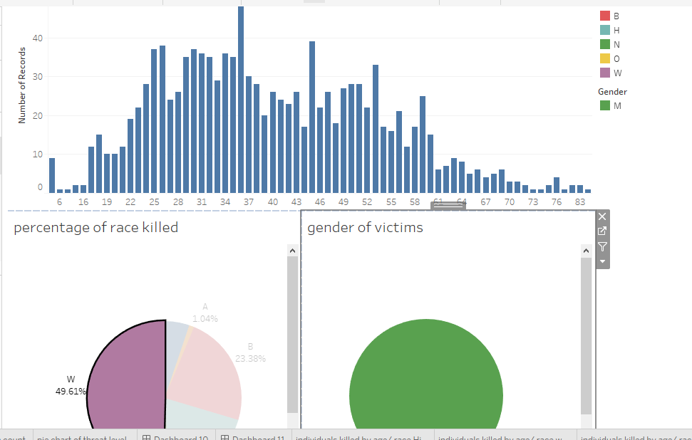
Here we are trying to see the age group of those killed, they gender and we are trying to filter or group them by race.
The age of Hispanics/Latinos killed tended to be lower than that of Whites killed, and Blacks had the lowest median age out of the groups. The median ages for the killed among Whites, Hispanics/Latinos and Blacks were 38, 31 and 30 respectively. However, it is important to note that the median ages for these groups for the general US population are 42.9, 28.1 and 33.3, respectively. That at least explains why the group of Whites killed had the highest median age. The tail end of the graphs for Whites also extended a lot further into older ages, but it’s understandable that they had more outliers as they made up over half the data-set. It’s also worth noting that the median age for Hispanics/Latinos in the US is driven down by the fact that a large portion of their community is 1st generation immigrants who tend to be younger than the US average age. They also tend to have more kids than the other 2 groups.
This dashboard can help community leaders and mayors engage the youths and different age brackets in programs that can benefit them such as vocational trainings, jobs, activities to keep them from crime and off the streets.
Target Audience: citizens, community leaders and mayors
Dashboard 12

Slide 22
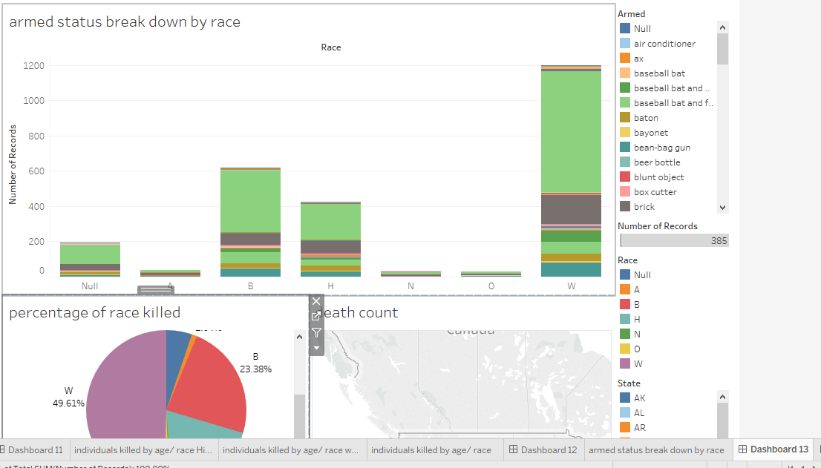
In this dashboard we are trying to know the armed status break down by race and try what cause of actions to officer take depending on the race.
If we assume that our data represents the general trends for police killings today, then Black people that are killed are more likely to be armed with a firearm (49.1% were in this case) than any other racial/ethnic group. It would also imply that they are less likely than any other racial/ethnic group to be armed with a knife when killed. More interestingly, if we exclude the 7 Arab-Americans, this would imply that black people are more likely than any other racial/ethnic group to be unarmed when killed (20.9% of black people killed in 2015 were unarmed). These insights, if true, can relate to the highly debated discussion of whether stereotypes associating black people with having firearms lead to more killings of unarmed black people.
Target Audience: citizens, community leaders and mayors, law enforcement agencies
Dashboard 13

Slide 23
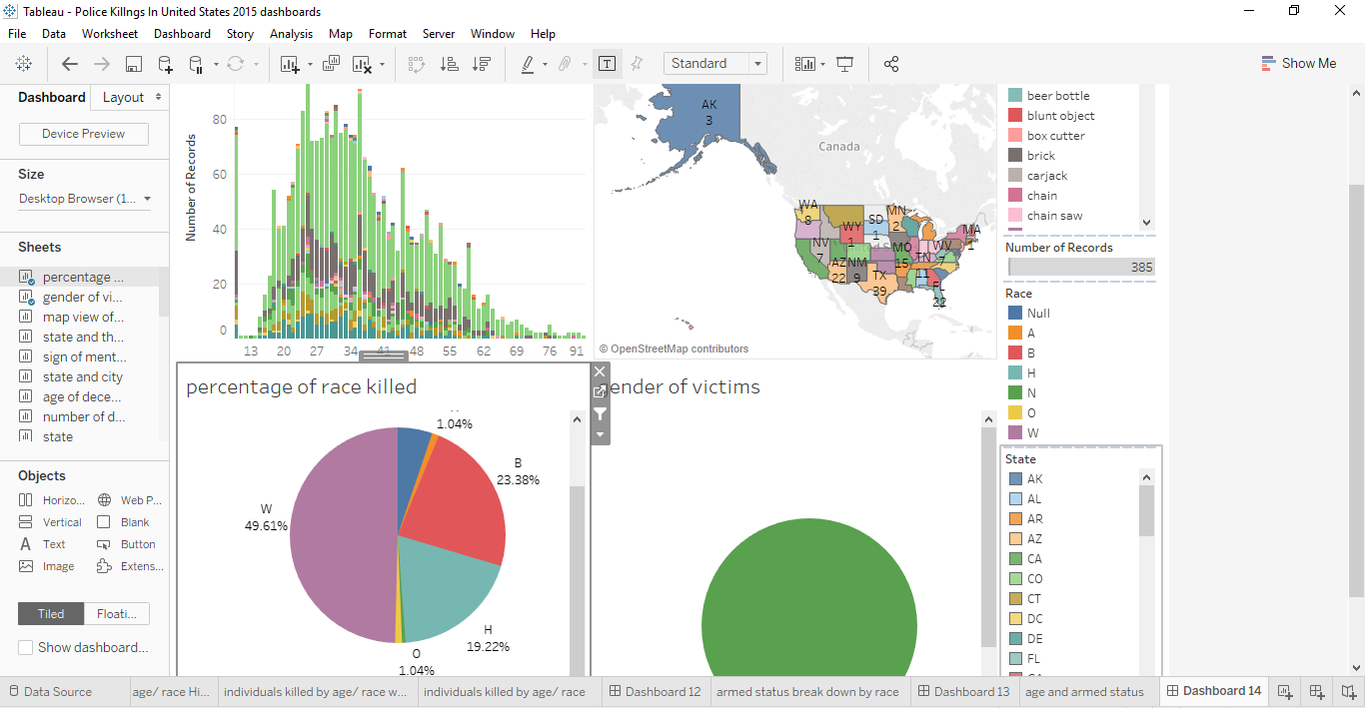
In this dashboard we are grouping each age group by weapons mostly used by them. We are filtering by states and race.
It intuitively makes sense that the oldest group had the highest percentage of white people. The percentage of white people tends to be higher in older age-groups in the US. The second one is quite interesting. Out of the age-groups, the minors (less than 18) killed had the lowest percentage of cases where they were armed with either a fire-arm or a knife. The under-18 group also had the highest percentage (26.3%) of cases where those killed were unarmed. Note that there isn’t enough information here to conclude that these statistics are reflective of the general population. But if they are found to be representative with further analysis, there should be cause for concern.
This dashboard can help community leaders and mayors engage the youths and different age brackets in programs that can benefit them such as vocational trainings, jobs, activities to keep them from crime and off the streets.
Target Audience: citizens, community leaders and mayors
Dashboard 14

Slide 24
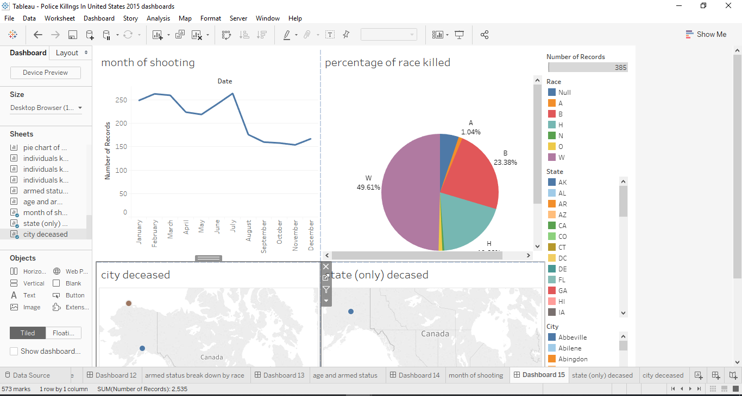
In this dashboard we group each killing by month and try to figure out what most had the most killings in each state, cities and what percentage of race or ethnicity was killed.
We can see that there is a cyclic trend here with periods of highs and lows. We cannot say this is a seasonal trend as we only have dataset for one year. We can see there is peak in police shootings in June. We can’t say for certain why there is an increase in June and if we had perhaps other information, we can analyze it better.
Target Audience: citizens, community leaders and mayors, law enforcement agencies
Dashboard 15

Slide 25
Part II
Predictive Analytics and Visualization of Insights
The variables with the highest level of relationships using the correlation algorithm in tableau are
First I went to the analyze tab and remove aggregate measure. Then drew the trend lines among the variables. The following were attributes had the highest correlation for my dataset
Age and race relationship
Date, death count and level of threat
The Race and manner of death
The Body cam and manner of death count

Slide 26
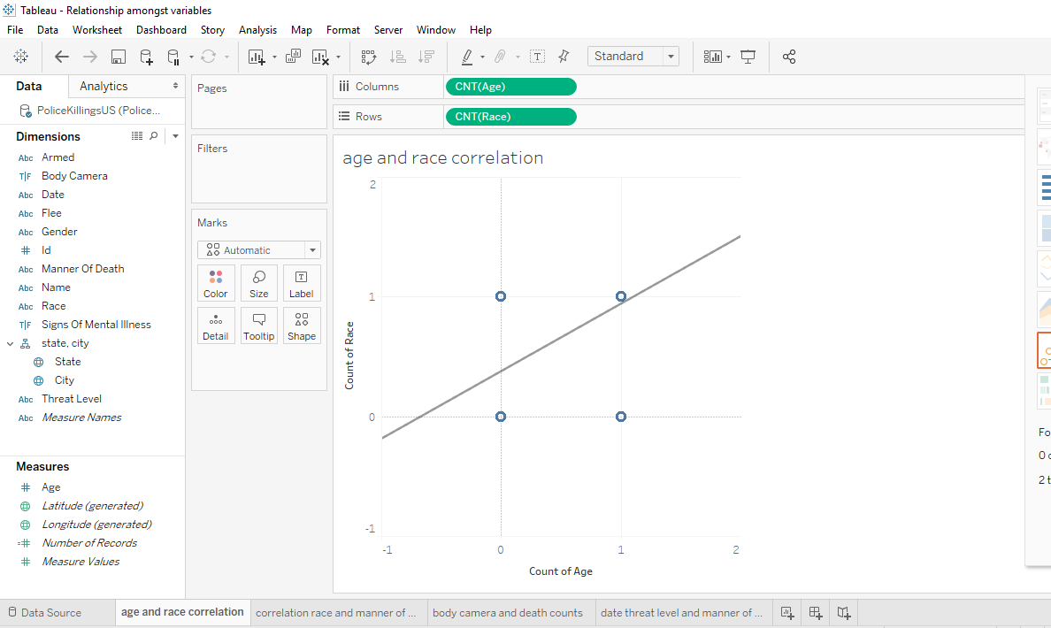
The root mean squared error here was 0.131. We can see there is a relationship between the age variable and the race variable. When we explore it further we have the following insights:
The age of Hispanics/Latinos killed tended to be lower than that of Whites killed, and Blacks had the lowest median age out of the groups. The median ages for the killed among Whites, Hispanics/Latinos and Blacks were 38, 31 and 30 respectively. However, it is important to note that the median ages for these groups for the general US population are 42.9, 28.1 and 33.3, respectively. That at least explains why the group of Whites killed had the highest median age. The tail end of the graphs for Whites also extended a lot further into older ages, but it’s understandable that they had more outliers as they made up over half the data-set. It’s also worth noting that the median age for Hispanics/Latinos in the US is driven down by the fact that a large portion of their community is 1st generation immigrants who tend to be younger than the US average age. They also tend to have more kids than the other 2 groups
Relationship 1 Age and Race Relationship

Slide 27
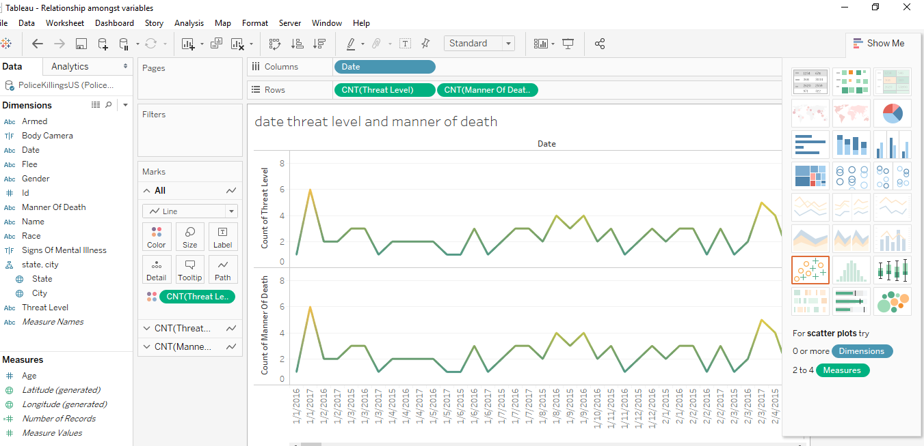
Relationship 2 date, count of manner of death
Here can see a relationship between date and death count. It looks like a cyclic trend with periods of high and low. We cannot say this is a seasonal trend as we only have dataset for one year. We are going to explore this further when we are doing a time series analysis of the dataset.

Slide 28
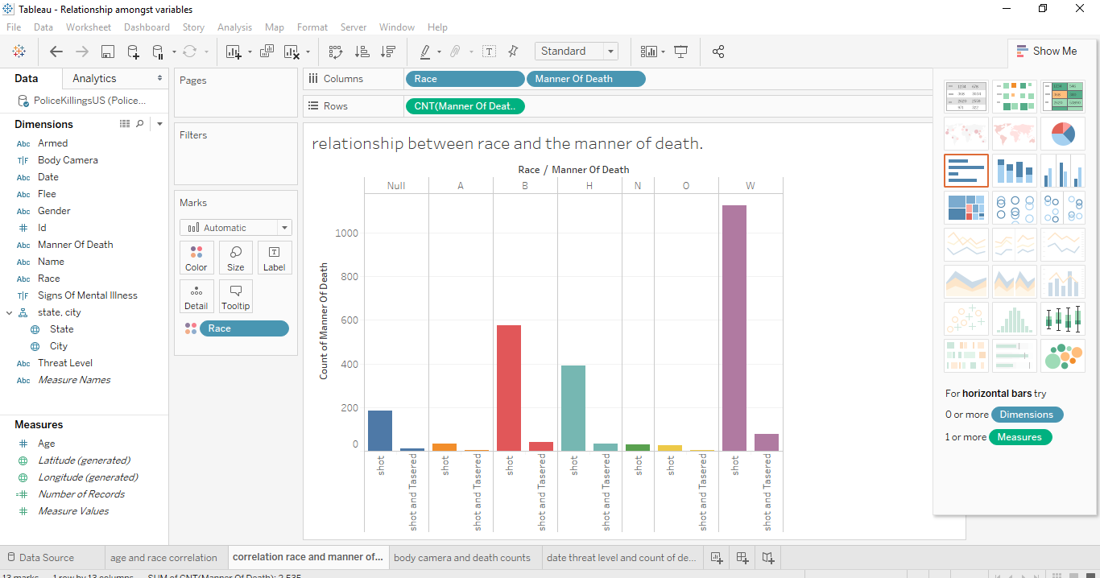
Relationship 3 of race and manner of death
There is also a relationship between race and the manner of death. Earlier we tried to show the number of those shoot because of their race.

Slide 29
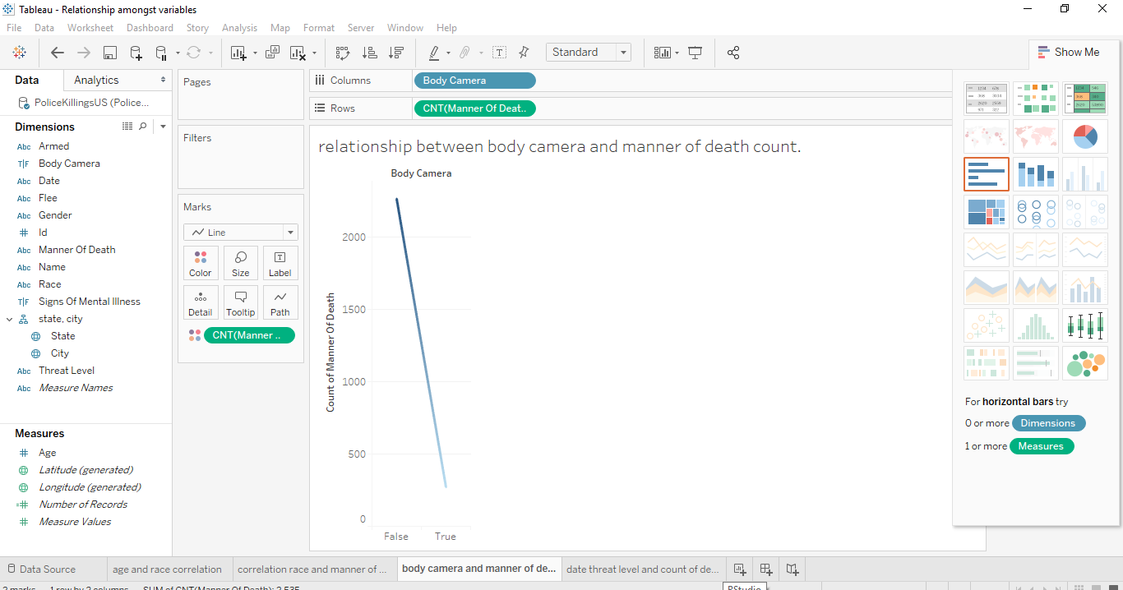
Relationship 4 The Body cam and the manner of death count
There is a relationship between body camera and manner of death count.
On a general overview we can see that the officers didn’t turn on their body camera with a staggering rate of 89.3% and they turn it on 10.69%. That’s a huge number. There is no excuse that an officer should turn off their body camera while making an arrest. An example would be the officer who shot and killed 18-year-old Paul O’Neal. The officer was wearing a body camera during the shooting, but the camera was turned off at the time.
Due to the frequent rate of officers turning of body cameras during shooting, there are plans to make a proposed Tennessee law would make it a felony for police officers to disable their body cams.

Slide 30
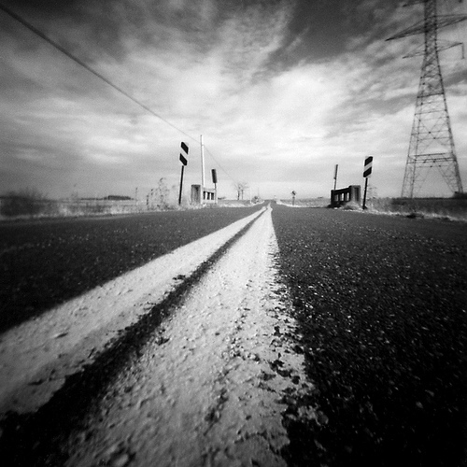
Predictive Analysis
01
Report and findings

Slide 31
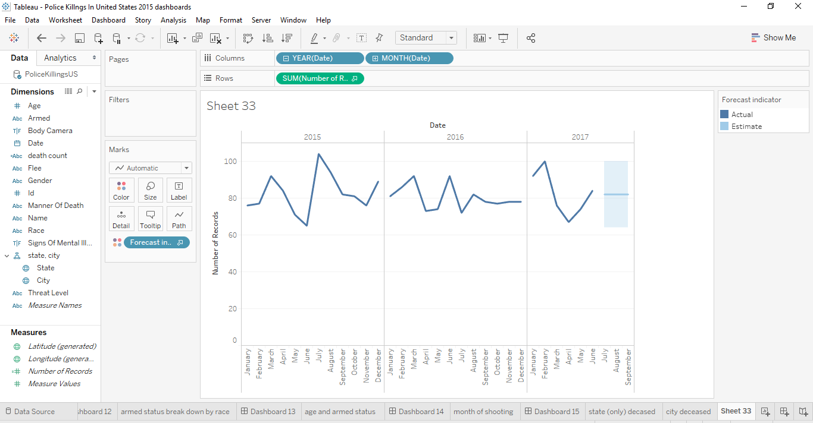
For the predictive model, tableau forecast function was used to predict the next 3 months of number of police killings in the US. Again this dataset is a cyclic trend, ups and down.

Slide 32
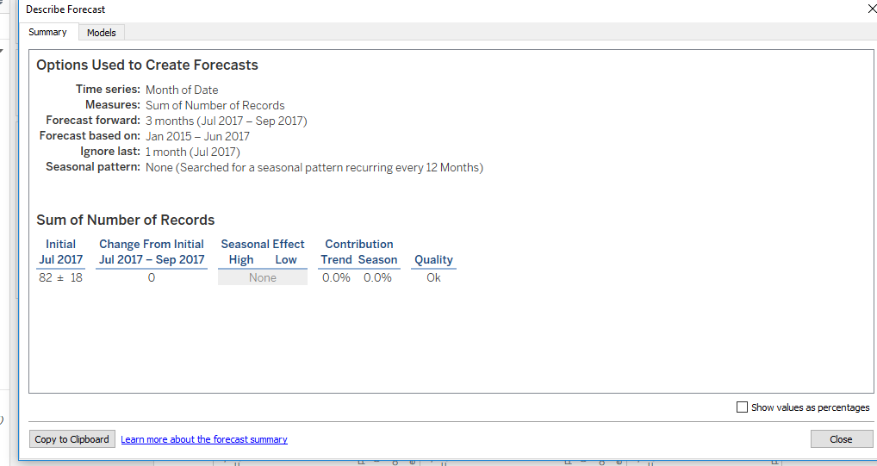
Our forecast model predicted 3 months from July 2017 - September 2017. It predicted that the number of killings will drop from 84 – 82 in those month periods (based on the historical data provided) with a 95% confidence level.
A description of our predictive model above
There was no element of seasonal effects and we ignored the first month with the forecast model based on January 2015 – June 2017.
The next screen shoot shows the cross tab of our forecasted values (orange) and our actual values (blue) as well as the lower prediction and upper prediction

Slide 33
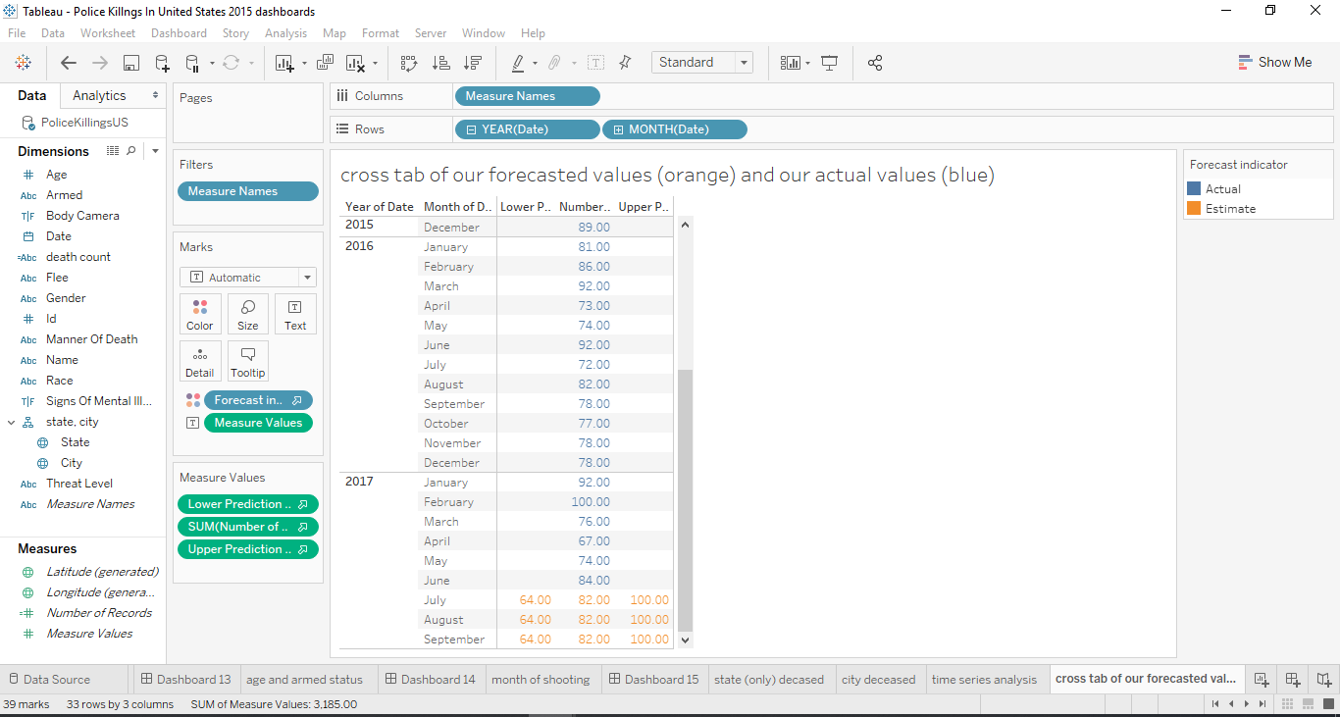
Cross tab view

Slide 34
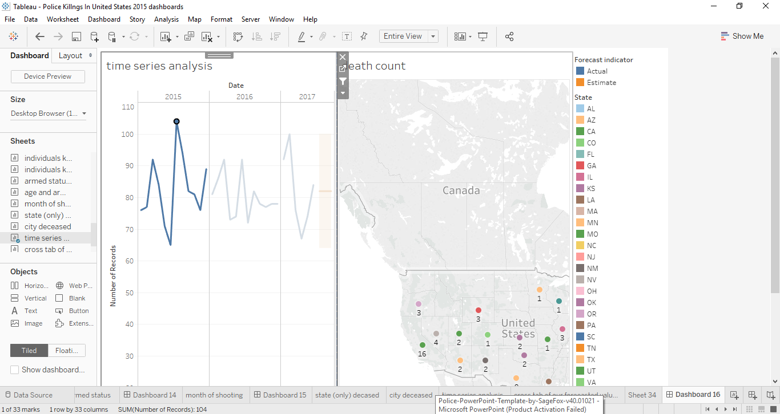
Cross tab view
time series dashboard of date and death count in each state

Slide 35
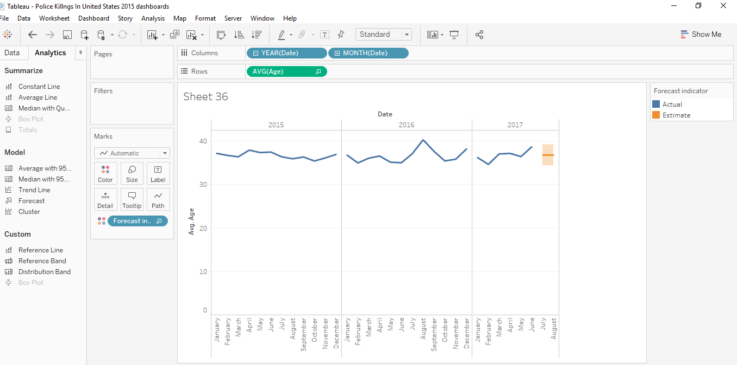
Our forecast model predicted 2 months from July 2017 – august 2017. It predicted that the average age killed will be 36.796 in those month periods (based on the historical data provided) with a 95% confidence level.

Slide 36
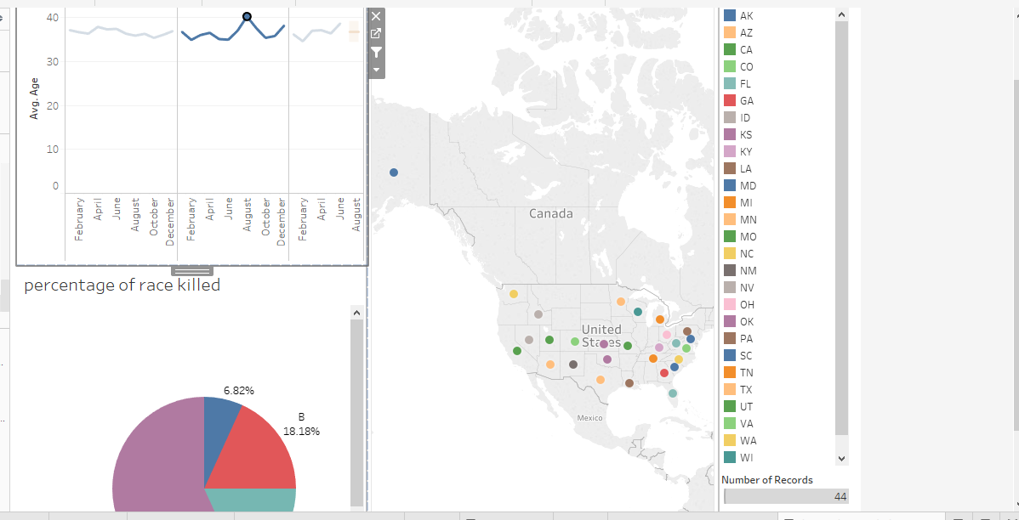
Time series dashboard showing the year and months of those killed as well as filter by states and race/ethnicity

Slide 37

Thank You
.

